Slide 1

Superstore Analysis
01

Slide 2
Purpose
Identify products that customers tend to purchase together
Uncover sales and profits trends

Slide 3


Technologies & Process
Data cleaning & analysis
Data analysis & visualization
Market basket analysis & association rules mining

Slide 4
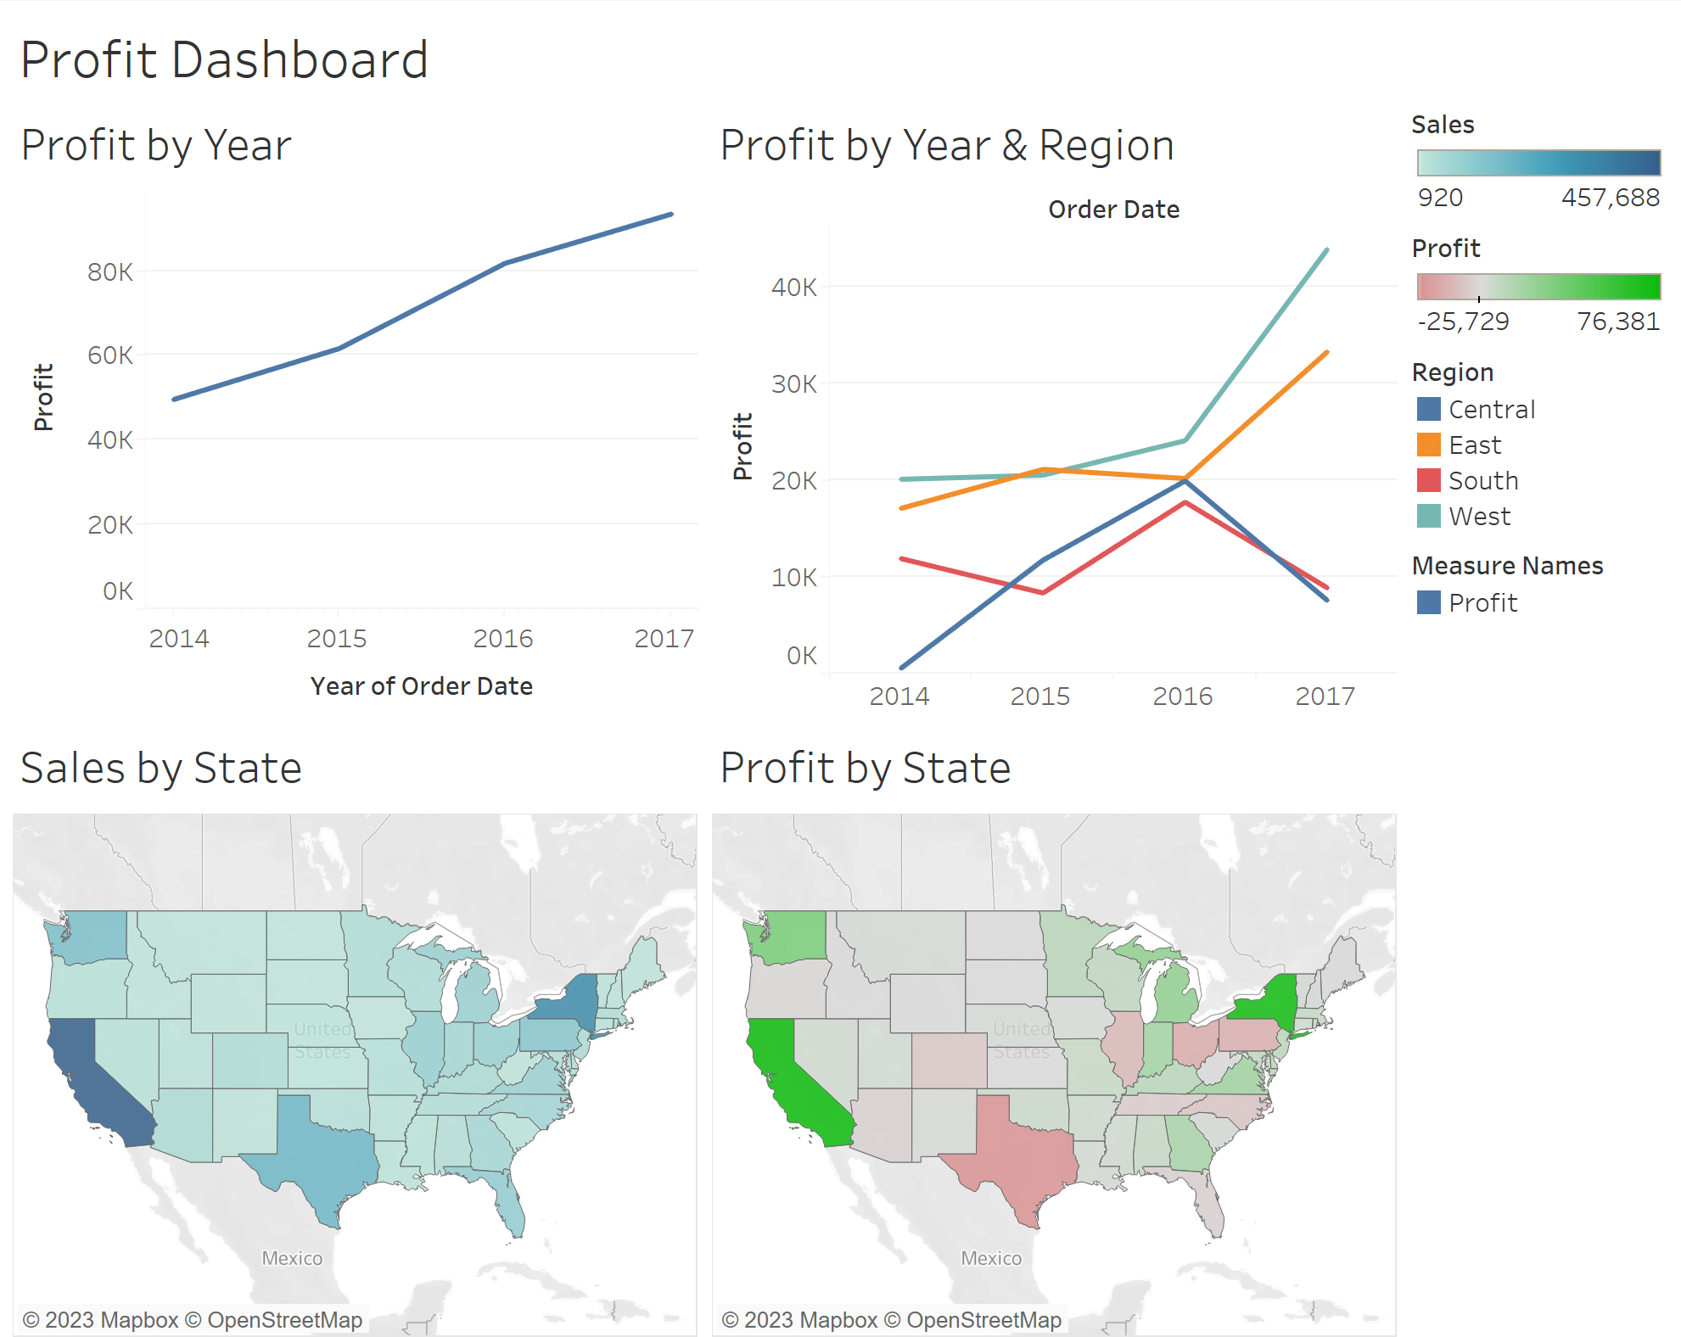

Slide 5
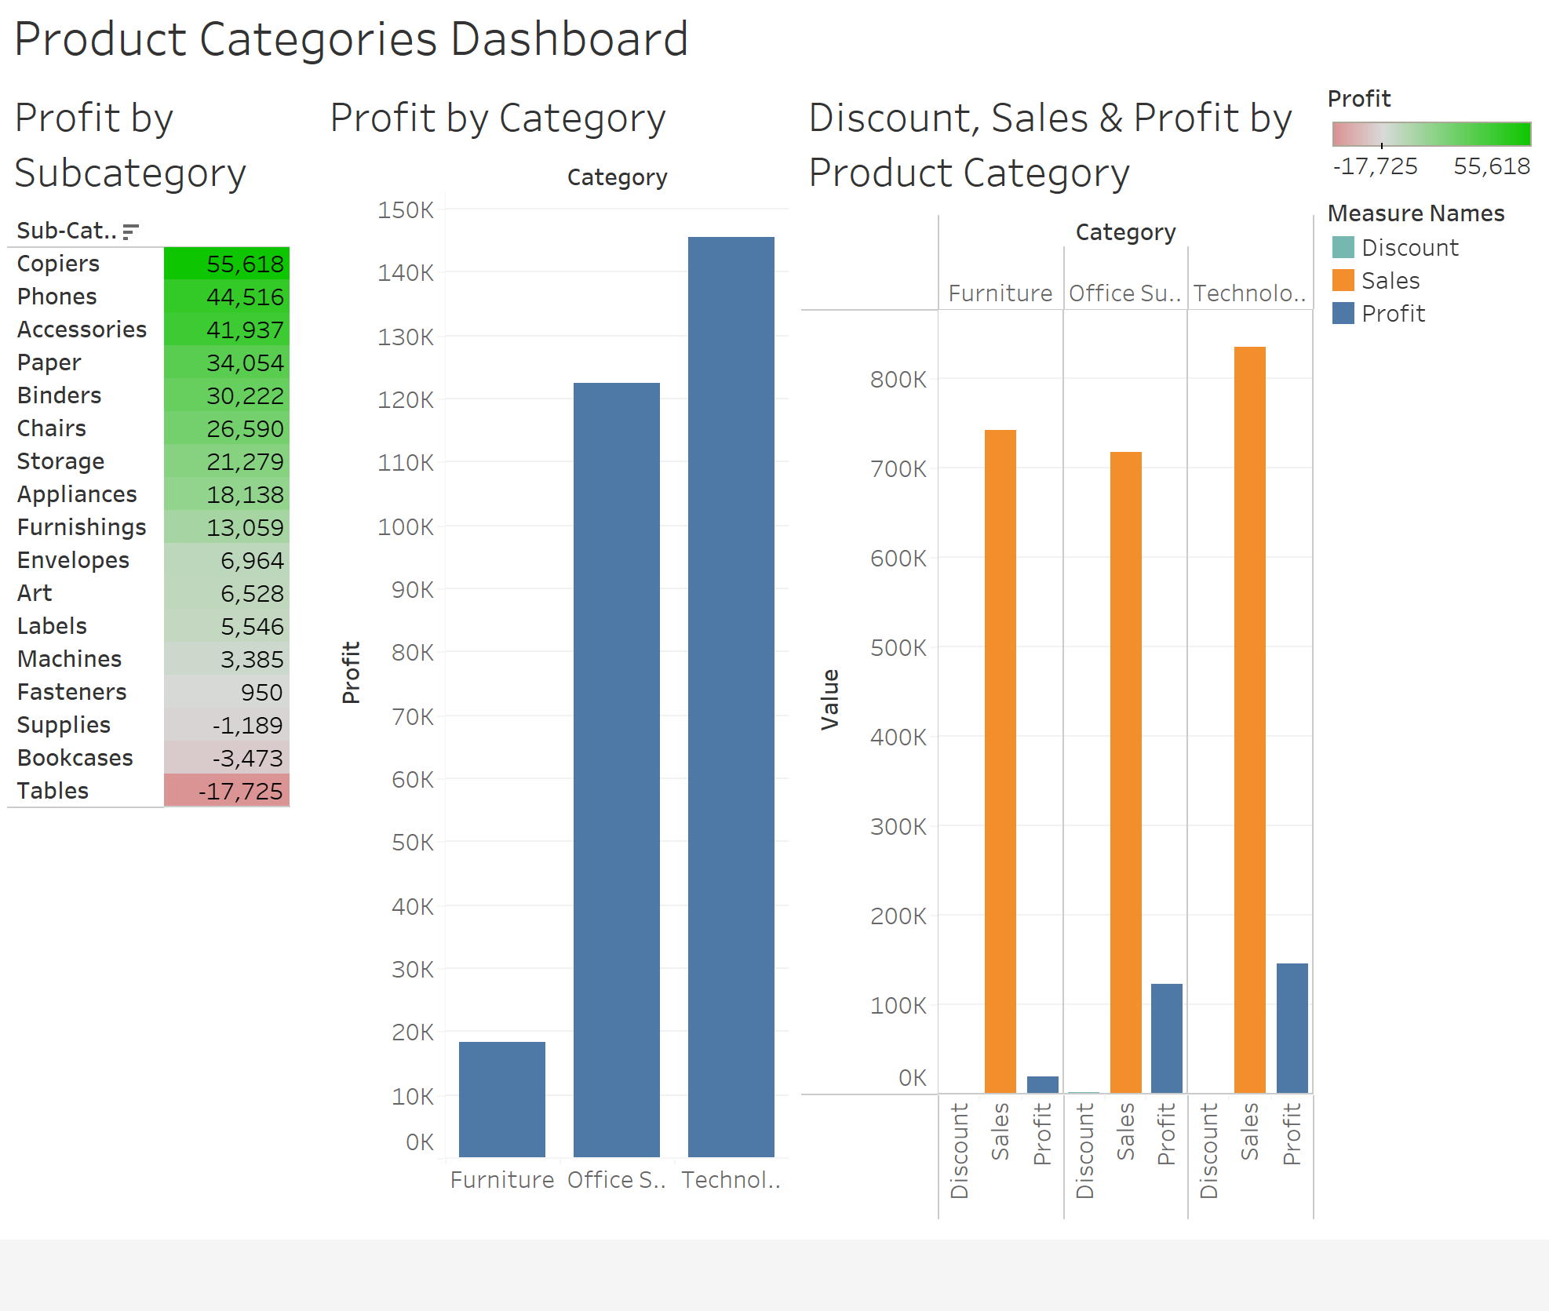

Slide 6
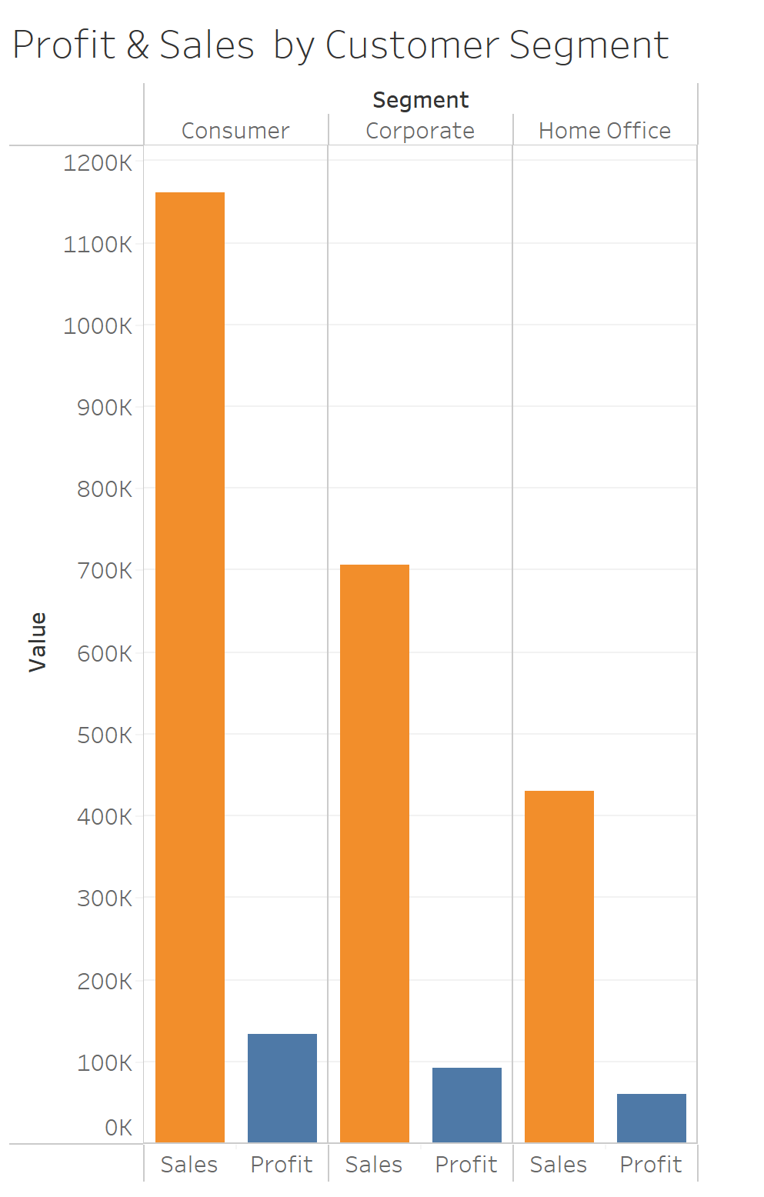
Half of sales made to consumers

Slide 7
Association Rules
1
2
No association rules with high minimum support Items that appear in 0.05% of transactions, no rules generated with min. confidence level of 70%
Can stop selling unprofitable products

Slide 8
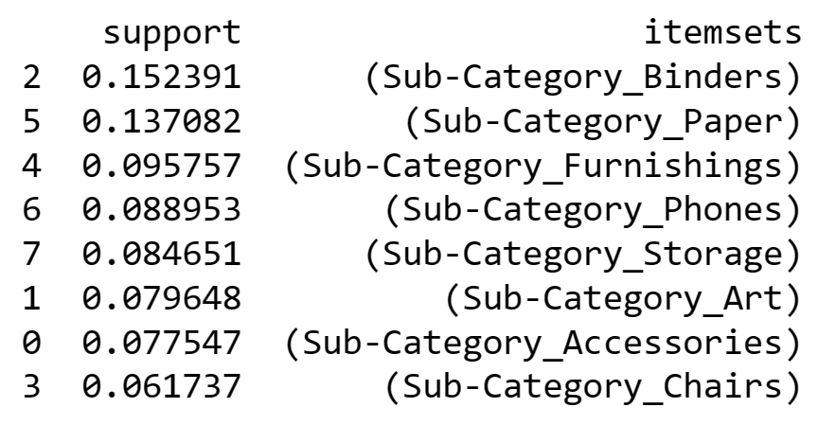
Sub-categories of products most commonly purchased together

Slide 9
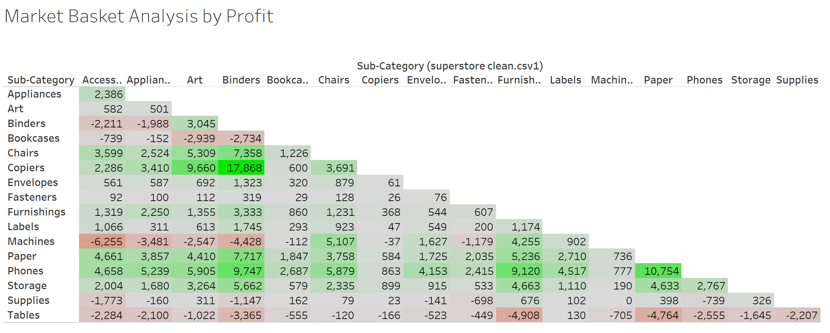

Slide 10
Thank you!

